Slide 1
Lab 2 Pressure and temperature
By Daksh Khandelwal

Slide 2
Objective and Experiment
To determine the relationship between temperature and pressure of a gas
Collecting pressure data with Phyphox by placing phones in a mason jar inside a fridge to cool down for 15 min.

Slide 3
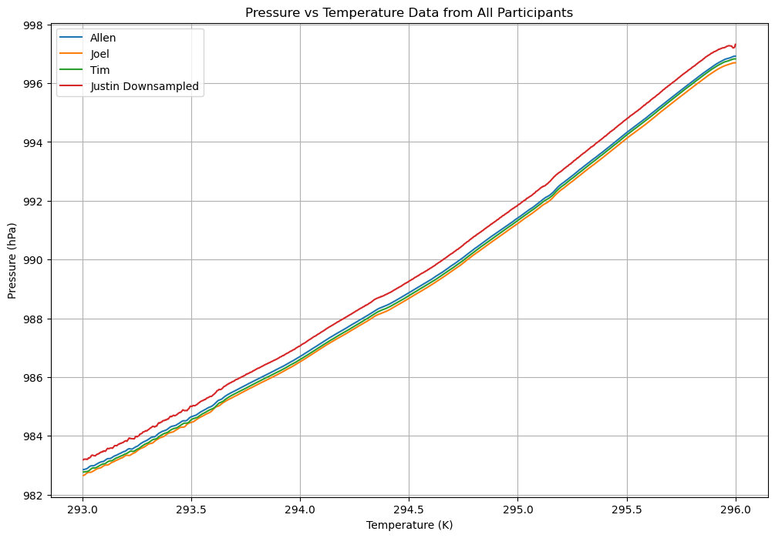
Raw data
Justin’s Android data was under sampled to match sample size of iPhone data for visualization and calculation purposes.
The android barometer appears to be calibrated differently from the iPhone’s (Allen, Joel, Tim)

Slide 4
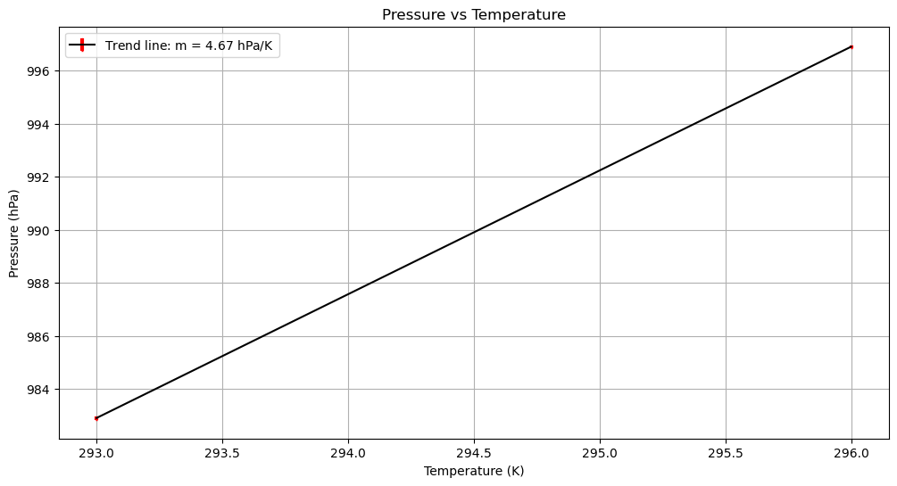
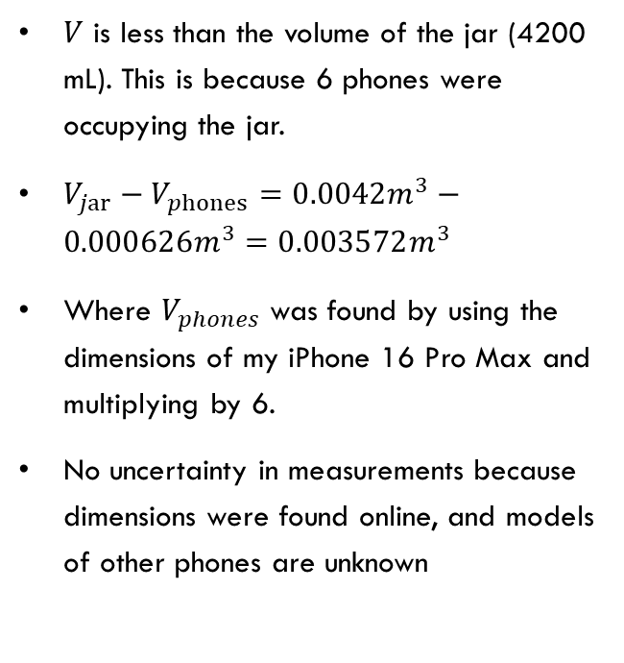
Jar volume
$V$ is less than the volume of the jar (4200 mL). This is because 6 phones were occupying the jar.
$V_{jar}−V_{phones}=0.0042m^{3}−0.000626m^{3}=0.003572m^{3}$
Where $V_{phones}$ was found by using the dimensions of my iPhone 16 Pro Max and multiplying by 6.
No uncertainty in measurements because dimensions were found online, and models of other phones are unknown

Slide 5
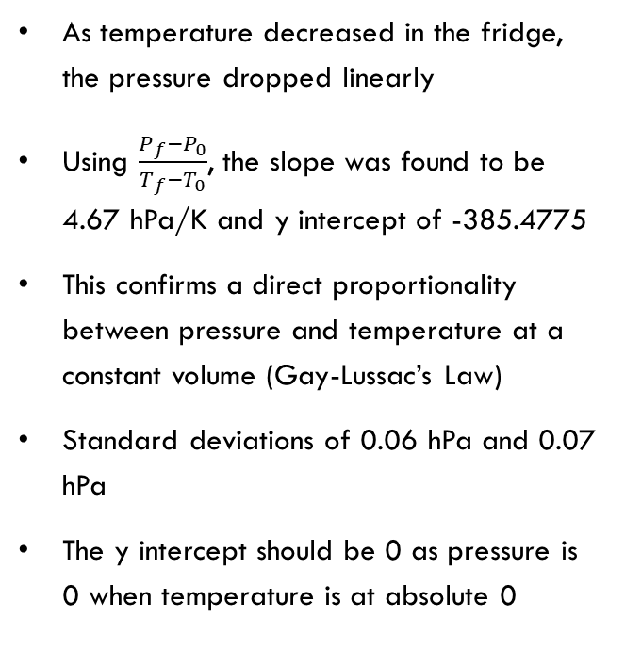
Trend line
As temperature decreased in the fridge, the pressure dropped linearly
Using $\frac{P_{f}−P_{0}}{T_{f}−T_{0}}$, the slope was found to be 4.67 hPa/K and y intercept of -385.4775
This confirms a direct proportionality between pressure and temperature at a constant volume (Gay-Lussac’s Law)
Standard deviations of 0.06 hPa and 0.07 hPa
The y intercept should be 0 as pressure is 0 when temperature is at absolute 0

Slide 6
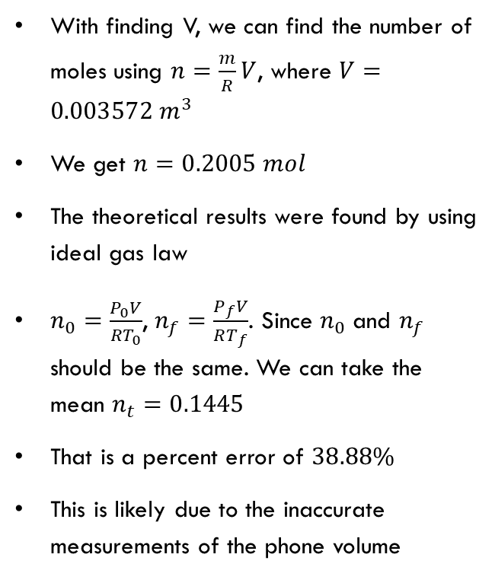
Error analysis
With finding V, we can find the number of moles using $n=\frac{m}{R}V$, where $V=0.003572 m^{3}$
We get $n=0.2005 mol$
The theoretical results were found by using ideal gas law
$n_{0}=\frac{P_{0}V}{RT_{0}}$, $n_{f}=\frac{P_{f}V}{RT_{f}}$. Since $n_{0}$ and $n_{f}$ should be the same. We can take the mean $n_{t}=0.1445$
That is a percent error of $38.88\%$
This is likely due to the inaccurate measurements of the phone volume

Slide 7
Conclusion
The experiment successfully demonstrated the Ideal Gas Law, the pressure temperature relationship remained linear as predicted
Result: the calculated number of moles was 0.2005
While there was a 38.9% error, the high correlation in the slope proves that a smartphone and a mason jar are effective tools for observing fundamental thermodynamic laws.

